Slide 1

airbnb in nyc
we nyc

Slide 2
Introduction: what is airbnb?
Why airbnb?
How to join airbnb?
Wrap Up

Slide 3
vacation rentals in nyc: a growing sector

Slide 4
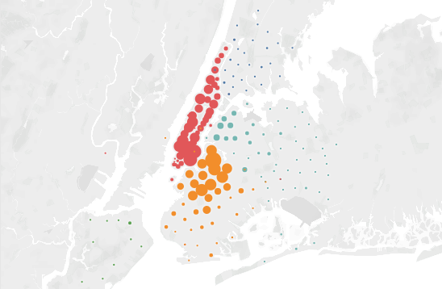
vacation rentals in nyc: a growing sector
Bronx
Brooklyn
Manhattan
Queens
Staten Island
<50
>1500
750

Slide 5

what is airbnb?
A company offering a digital platform for property renting
More than 2 million properties in 192 countries
Kind of users: Host or Guest
As a host, create profiles for your properties

Slide 6
Introduction: what is airbnb?
Why airbnb?
How to join airbnb?
Wrap Up

Slide 7



why airbnb? trusted by tourists
reviews count
average score
90,006
93

Slide 8





why airbnb? trusted by property owners
Angela, 39
Scott, 47
George, 62
Laureen, 26
Michaela, 22
Lawyer
Garden Equip. Supplier
Retired
PhD student
Trader
since October 2013
since August 2011
since September 2009
since May 2014
since January 2015
Apartment in Manhattan
Second property
Loft in Manhattan
Inherited from parents
Apartment in Bronx
Own acquisition
House in Bronx
Spare room
Loft in Brooklyn
Acquired for airbnb

Slide 9
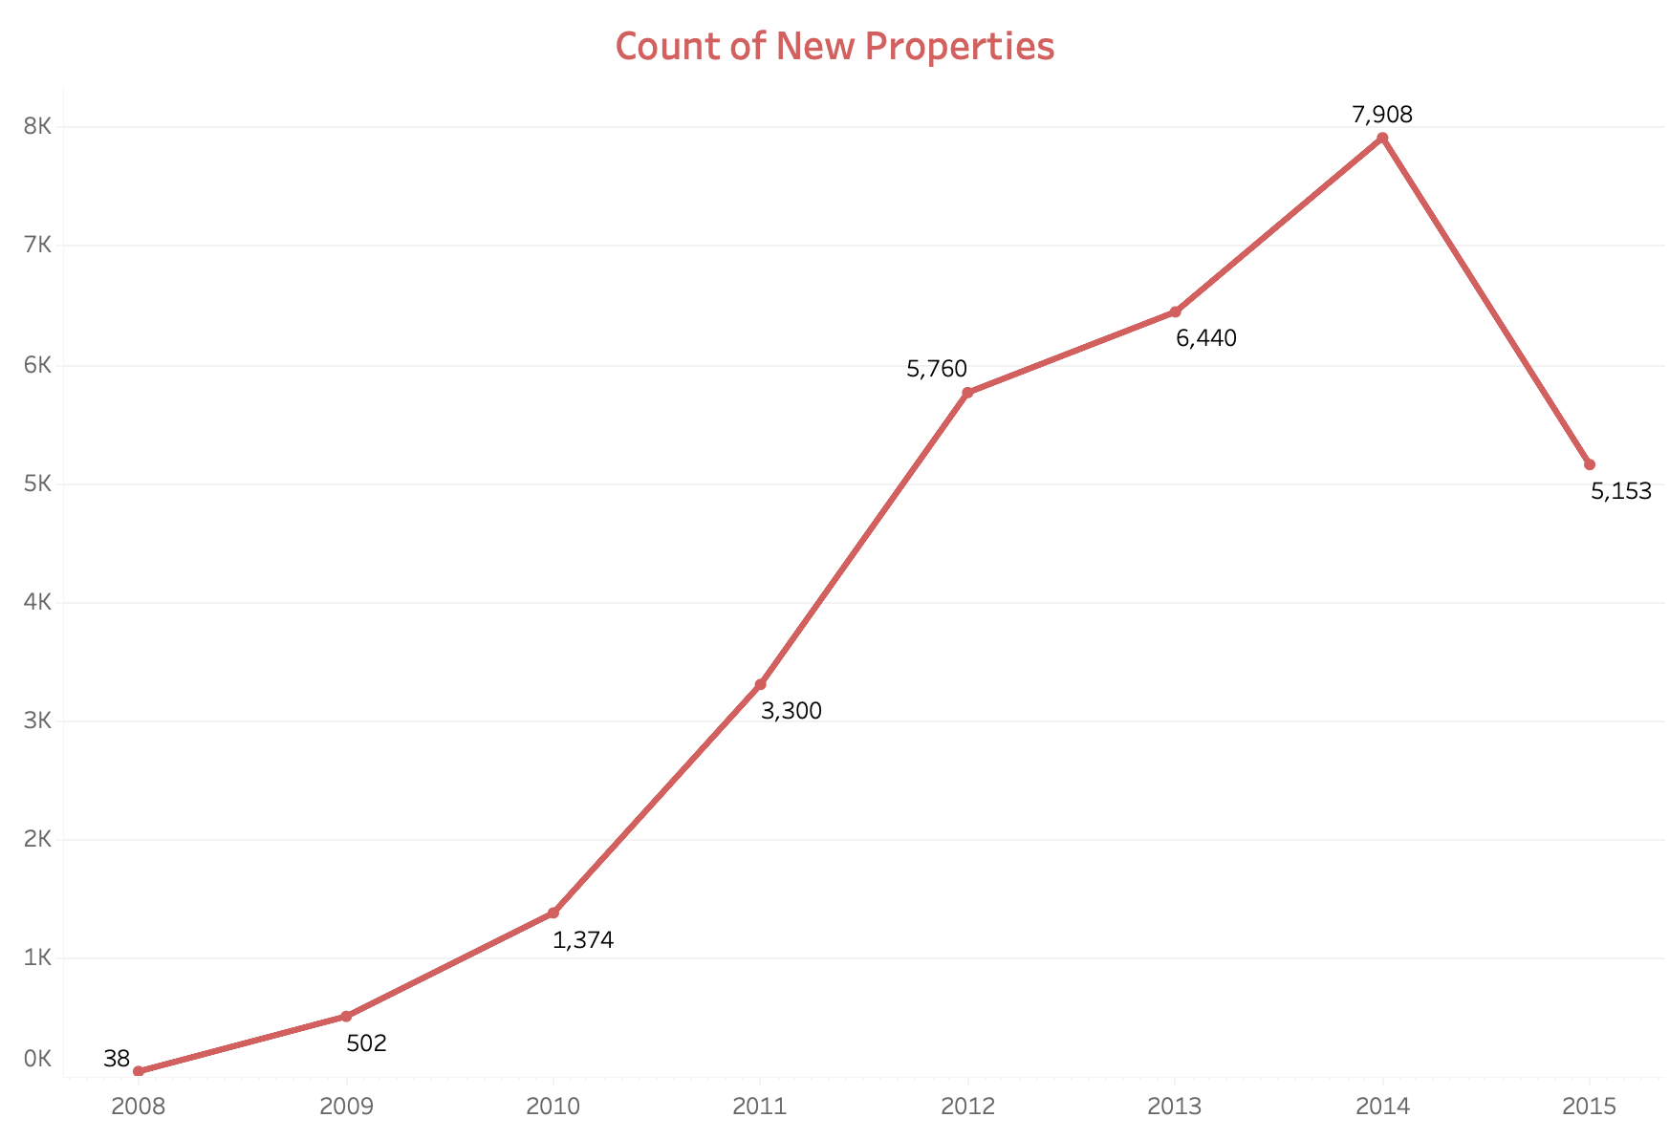
why airbnb? trusted by property owners
Count of new properties

Slide 10
why airbnb? vs. regular
renting
150 million global users
Availability of market analysis tools
Automatically generated hiring contracts
Legal guarantees and protection for property owners

Slide 11

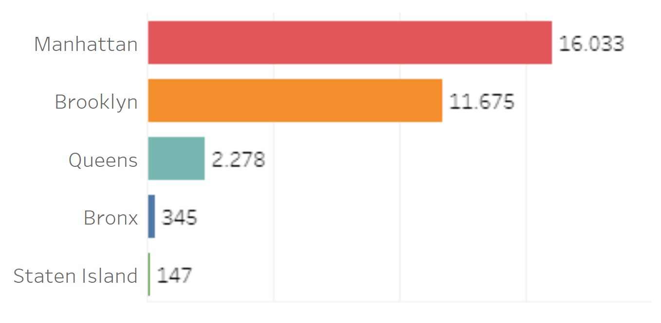
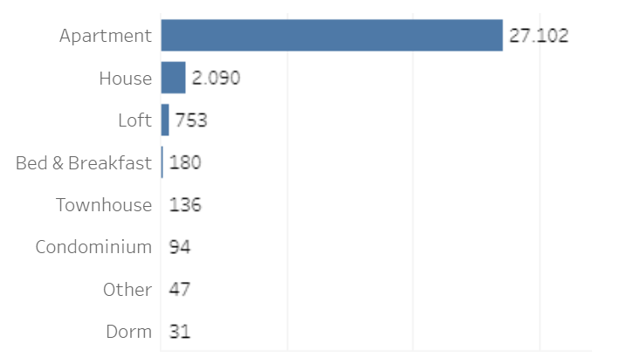
who joins airbnb? all kind of properties
neighborhood
property type
airbnb in
NYC
price average
$164

Slide 12
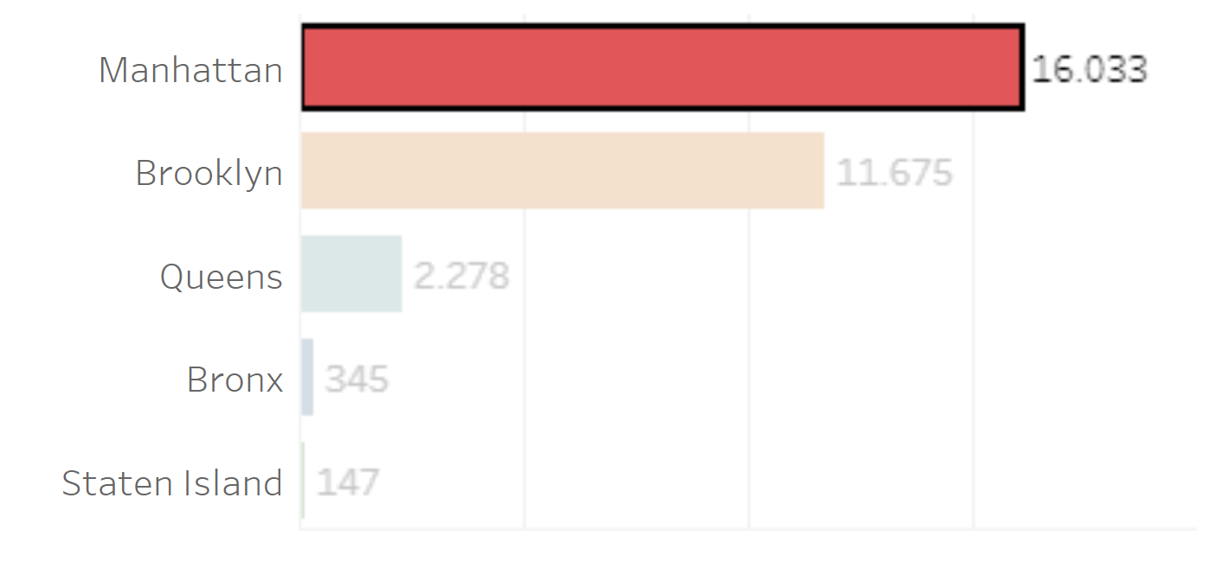
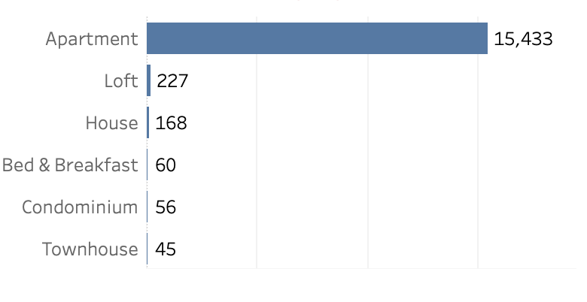
airbnb: an opportunity for everyone
neighborhood
property type
Angela, 39
Apartment in Manhattan
price average
$197
Scott, 47
Loft in Manhattan

Slide 13
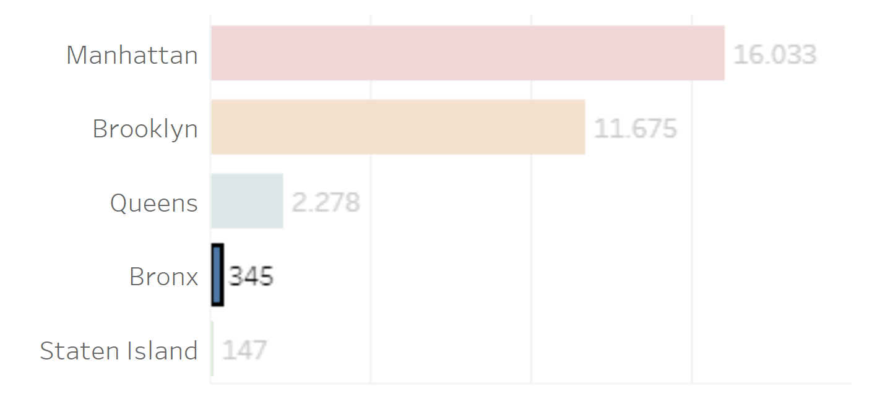
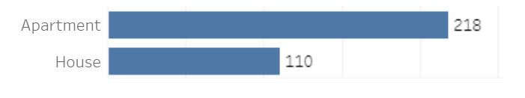
airbnb: an opportunity for everyone
neighborhood
property type
George, 62
Apartment in Bronx
price average
$214
Laureen, 26
House in Bronx

Slide 14
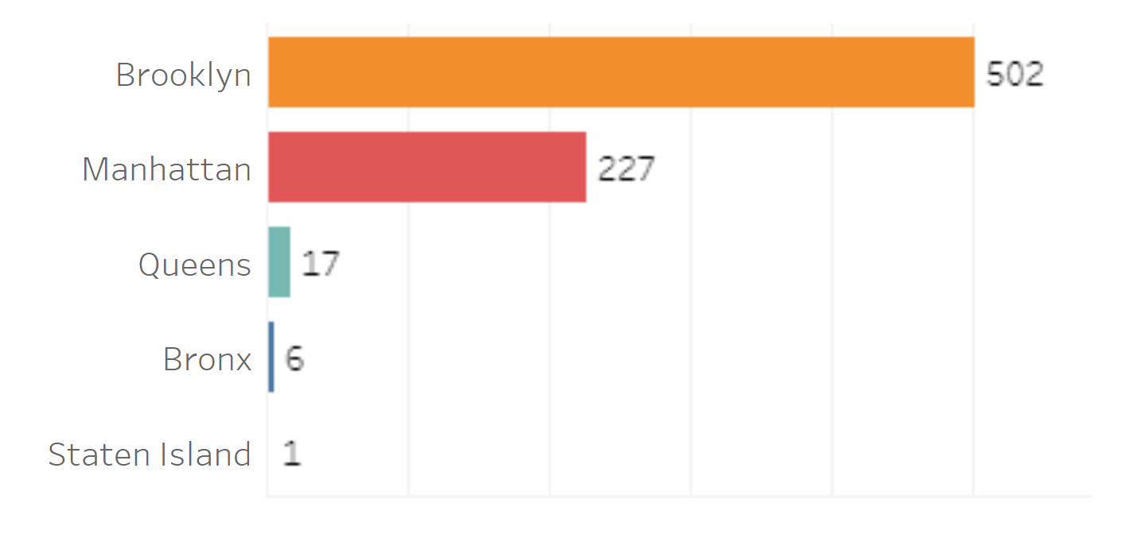
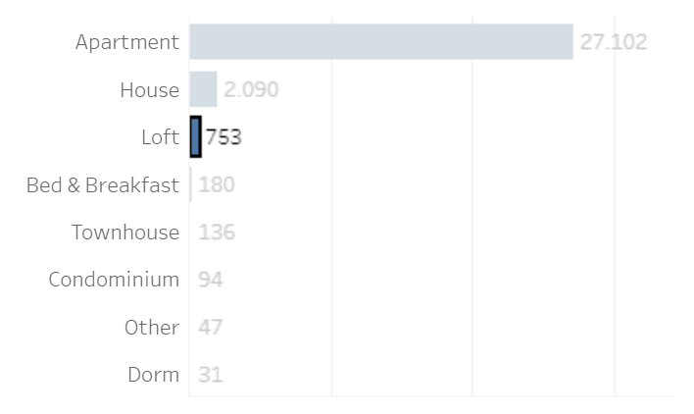
airbnb: an opportunity for everyone
neighborhood
property type
Michaela, 22
price average
Loft in Brooklyn
$263

Slide 15
Introduction: what is airbnb?
Why airbnb?
How to join airbnb?
Wrap Up

Slide 16




how to join airbnb?
Starting your listing
Setting your controls
Prepping your space
Tidy up
Tell us the basics
Add your House Rules
Store your valuables
Take photos of the space
Set your calendar
Stock up on essentials
Pick your prices
Provide check-in details
Highlight unique
details
Review your local laws
Add the finishing touches

Slide 17











how does airbnb work?
your first guests
START
END

Slide 18
how does airbnb work? guarantees
We offer a special property insurance for our hosts
We also have a legal team in case of a major incident
You will have instant access to a community of hosts near your property

Slide 19
Introduction: what is airbnb?
Why airbnb?
How to join airbnb?
Wrap Up

Slide 20






airbnb: endgame
Trust
Invest
Prosperity
Secure
Community

Slide 21
airbnb in nyc: time for questions
thanks for listening

Slide 22

airbnb in nyc
we nyc

